Slide 1

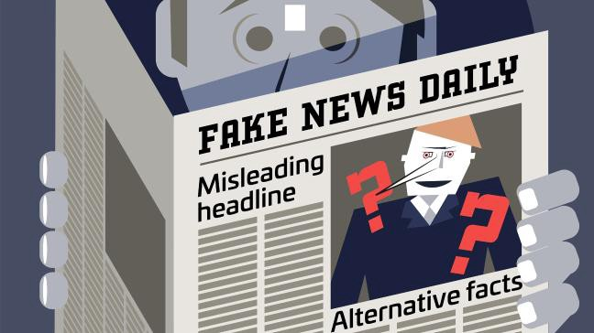

Machine Learning for Fake News Detection
Presented : Aditya R Padmawar(305086)
Guided : Prof. N.A.Mhetre

Slide 2
Introduction
In the recent years, online content has been playing a significant role in swaying users decisions and opinions.
Recently it has become apparent that opinion spam does not only exist in product reviews and customers feedback. In fact, fake news and misleading articles is another form of opinion spam, which has gained traction.
Some of the biggest sources of spreading fake news or rumors are social media websites such as Facebook, Twitters, and other social media outlet.
We discuss various techniques to detect fake news, which consists of using text analysis based machine learning classification techniques.
06/03/2019

Slide 3
Motivation
The goal is to attempt to tackle the growing issue of fake news, which has been exacerbated by the wide-spread use of social media.
For example, many believe fake news on social media to be a large contributing factor to results of the controversial 2016 US election and also to verify any article or news before coming to any conclusion.

Slide 4
Objectives
To eliminate or reduce the Fake News in Circulation.
To Stop the rumors.
To create an easy-to-use system to detect the credibility of a user’s claim or article.
To stop the spread of misinformation.

Slide 5

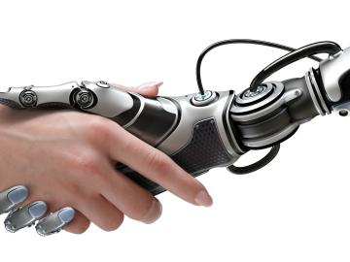


Machine Learning
Machine Learning is the branch of computer science that deals with the development of
computer programs that teach and grow themselves. According to Arthur Samuel, an
American pioneer in computer gaming, Machine Learning is the sub-field of computer
science that ”gives the computer ability to learn without being explicitly programmed.”
Machine Learning allows developers to build algorithms that automatically improve themselves
by finding patterns in the existing data without explicit instructions from a human
or developer. Machine Learning relies entirely on the data; the more the data, the more
efficient Machine Learning is.

Slide 6


Fake News
There are many different categories misinformation can fall into. There are articles that are blatantly false, articles that provide a truthful event but then make some false interpretations,
articles that are pseudoscientific, articles that are really just opinion pieces disguised as news, articles that are satirical, and articles that are comprised of mostly tweets and quotes from other people.

Slide 7
Problem Statement
How to Detect Fake News using Machine Learning ?
Since this problem is a kind of text classification, Implementing a Naive Bayes classifier will be best as this is standard for text-based processing. Classification is a type of Machine Learning algorithm which is a domain of supervised learning. In Supervised Learning humans have to teach the machine how to learn.

Slide 8
Naive Bayes Classifier
It is a classification technique based on Bayes’ Theorem with an assumption of independence among predictors.
In simple terms, a Naive Bayes classifier assumes that the presence of a particular feature in a class is unrelated to the presence of any other feature.
For example, a fruit may be considered to be an apple if it is red, round, and about 3 inches in diameter.
Even if these features depend on each other or upon the existence of the other features, all of these properties independently contribute to the probability that this fruit is an apple and that is why it is known as ‘Naive’.

Slide 9
Mathematical Model
Pr(F—W) =
Pr(W—F)Pr(F)/
(Pr(W—F)Pr(F)+Pr(W—T)Pr(T))

Slide 10
where:
Pr(F—W) conditional probability, that a news article is fake given that word W appears in it;
Pr(W—F) conditional probability of finding word W in fake news articles;
Pr(F) overall probability that given news article is fake news article;
Pr(W—T) conditional probability of finding word W in true news articles;
Pr(T) overall probability that given news article is true news article.

Slide 11
This formula is derived from Bayes theorem. Consider that probabilities
Pr(F—W) are known for each word of
the news article.
Next step is combining this probabilities to get the probability of the fact, that given news article is fake.

Slide 12
The formula for this looks as following:
p1 = Pr(F—W1)...Pr(F—Wn)
p2 = (1 Pr(F—W1))...(1 Pr(F—Wn))
p = p1/(p1 + p2)

Slide 13
where:
n total number of words in the news article;
p1 product of the probabilities that a news article is fake given that it contains a specific word for all of the words in the news article;
p2 same as p1, but complement probabilities are used instead;

Slide 14
Pr(F—W1), Pr(F—W2) Pr(F—Wn) conditional probabilities that a news article is a fake, given that words
W1, W2, Wn respectively appear in it;
p the overall probability of the fact that given news article is fake.

Slide 15
Detection Process

Slide 16
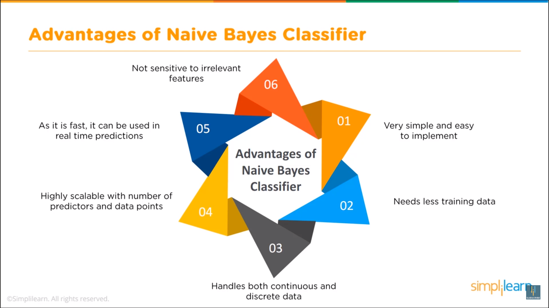
Advantages of Naive Bayes Classifier

Slide 17

Related Work
IIIT-Delhi students create WhatsFarzi app to detect fake news WhatsFarzi is the brainchild of three students of IIIT-Delhi. The app will track content on the internet and check it with authentic websites to curb spread of misinformation otherwise known as fake news.The app is also capable of verifying photos and scanning
their authenticity
through image
tampering algorithms.

Slide 18
Conclusion
The results obtained are very promising. Despite the high performance of our classifier, there is definitely scope for improvement.
We evaluated the models using absolute probability thresholds, which may not be
the most reliable for models where probability
scoring is not well-calibrated.

Slide 19
References
[1] Shlok Gilda, Department of Computer Engineering, Evaluating Machine Learning Algorithms for Fake News Detection,2017 IEEE 15th Student Conference on Research and Development (SCOReD).
[2]N. J. Conroy, V. L. Rubin, and Y. Chen, Automatic deception detection: Methods for finding fake news, Proceedings of the Association for Information Science and Technology, vol. 52, no. 1, pp. 14, 2015
[3]Hadeer Ahmed1, Issa Traore1, and Sherif Saad2 1 ECE Department, University of Victoria, Victoria, BC, Canada 2 School of Computer Science, University of Windsor, Windsor, ON, Canada
[4] https://indianexpress.com/article/education/iiit-delhi-students-create-whatsfarziapp-to-detect-fake-news-5599996/
[5] https://www.csail.mit.edu/news/detecting-fake-news-its-source
[6]https://kastanday.com/fake-news-detection-details/machinelearningforstancedetection

Slide 20
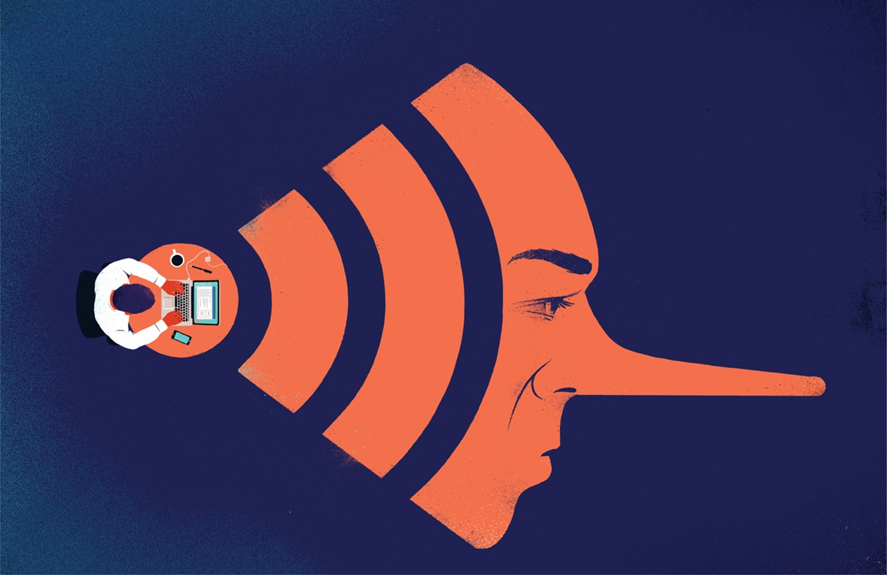
Questions?

Slide 21
Thank-You

